Slide 1

Title: TACTICAL RESCUE ANALYSIS SYSTEM USING IOT
ANNAMALAI UNIVERSITY
ELECTRONICS AND COMMUNICATION ENGINEERING
PROJECT MEMBERS:
EZHILARASAN. R -221010016
GUNA .R -221010018
AKASH. A -222010055
VEERASELVAM .R -211010038
PROJECT GUIDE:
DR .R. GAYATHRI

Slide 2
ABSTRACT:
The Tactical Rescue Analysis System is an IoT-based framework designed to enhance the safety and efficiency of emergency response operations. In hazardous scenarios where human entry is restricted, this system utilizes a network of environmental and biological sensors to monitor real-time conditions. By integrating microcontrollers (like Arduino or ESP32) with a cloud platform (Firebase), the system collects data on gas levels, temperature, and victim location. This data is analyzed to provide rescue teams with an "actionable map" of the site, significantly reducing response time and minimizing risks to both the victims and the rescuers.

Slide 3
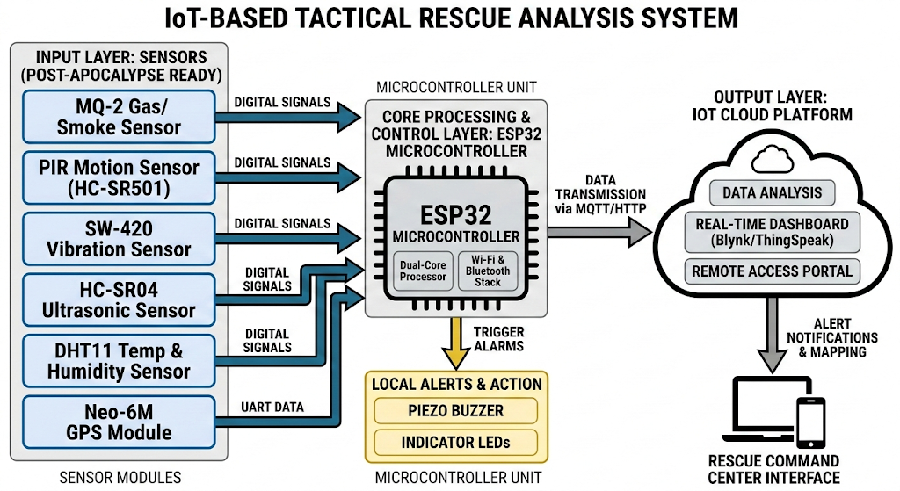

Slide 4
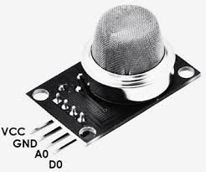
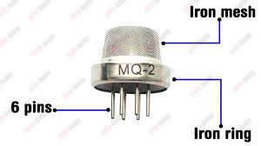
Sensor: MQ-2 Gas Sensor
What it does: Smells things humans can’t.
Simple Explanation: In a post-apocalypse, fires or chemical leaks from old factories are common. This sensor "sniffs" the air for smoke, cooking gas (LPG), or leaking methane.
Prevention: It triggers a buzzer … the rescue team enters a basement or tunnel, preventing suffocation or explosions.

Slide 5
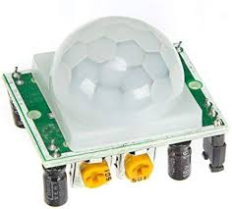
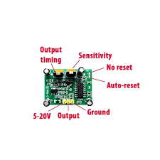
Sensor: PIR Motion Sensor (HC-SR501)
What it does: Sees "heat in motion.“
Simple Explanation: It detects the infrared heat coming off a human body.
Post-Apocalypse Use: Used to find survivors trapped under light debris or to guard a "Safe Zone" perimeter against intruders (raiders or wild animals) at night.

Slide 6
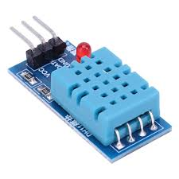
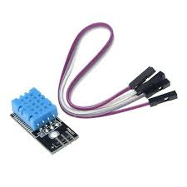
Sensor: DHT11 Temperature &Humidity
What it does: Checks the climate.
Simple Explanation: Extreme heat (from leftover fires) or freezing cold can kill a survivor just as fast as a wound.
Prevention: It monitors the "Micro-climate" of a rescue pod to ensure the trapped victim isn't suffering from hypothermia or heat exhaustion.

Slide 7
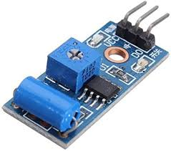
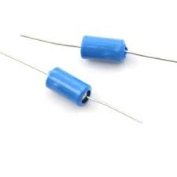
Sensor: SW-420 Vibration Sensor
What it does: Feels the ground shake.
Simple Explanation: Post-apocalyptic buildings are decaying and shaky. This sensor is like a digital "ear" pressed to the wall.
Prevention: If a wall starts to shift or a secondary earthquake (aftershock) occurs, the sensor detects the vibration and tells the rescue team to GET OUT immediately.

Slide 8
REAL TIME APPLICATIONS:
GLeak Alerts: Real-time warnings for toxic smoke and chemical leaks.
Structure Safety: Detects building instability to prevent rescuer injury.
Zero-Visibility Nav: Maps safe paths through thick smoke or darkness.
Remote Triage: Sends GPS locations and site vitals to medical teams.
Survivor Detection: Finds trapped humans using heat and motion sensors.

Slide 9
CONCLUTION:
Minimizes Risk: Prevents rescuer injury by detecting invisible gas and structural threats.
Saves Time: Pinpoints survivors instantly, skipping the "search" and starting the "rescue."
Low Cost: High-tech tactical monitoring built with affordable, rugged IoT sensors.
Actionable Data: Turns a chaotic disaster site into a clear, live map for the team.
"Smarter sensors. Faster rescue. Saved lives."

